Slide 1
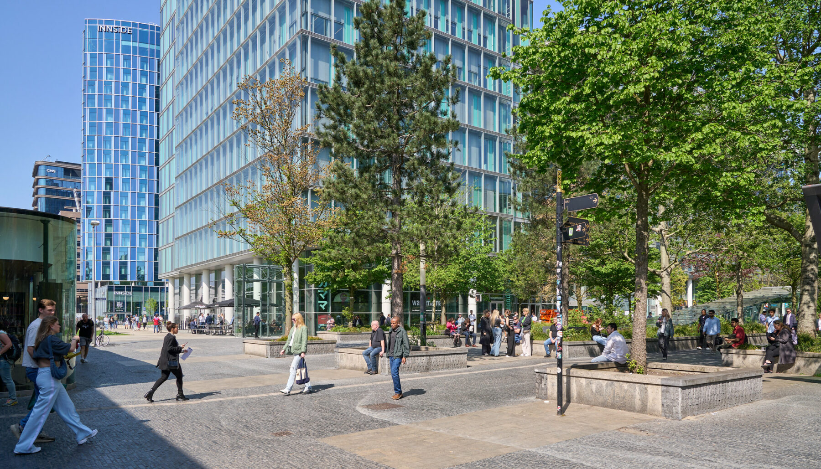
Title slide + symbol #1
Building Level Pedestrian Trip Generation
For Dutch Urban Areas Using Open Data | Gaby van der Star
Notes:
Alright let’s start,
First of thank you all for coming to my defense.
Today I will tell you about the building level pedestrian trip generation model I developed for my master thesis.

Slide 2
Agenda
1 Introduction
2 Context
3 Base Method
4 Component 1
5 Component 2
Motivation
Literature Gap
Objective
Available Data
Dutch Context
Fine Resolution
UNA Base
Methodology
Results
Methodology
Results
6 Component 3
7 Generate Trip
8 Validation
9 Discussion
10 Conclusion
Methodology
Results
Methodology
Results
Manual Counts
Face Validation
Limitations
Furture Research
Contributions
Use
Notes:
I will start with introducing the topic, giving the motivation and the objective.
The objective introduces the context in which the model will be applied leading to literature study which will form the basis of my model.
From my methodology I will highlight three components for which I will explain per component the methodology and the results.
These component together to generate trips, which I will evaluate with a face validation and the implications will be noted in the discussion and conclusion.

Slide 3



Motivation
Problem
Strain on accessibility due to urbanization
Solution
Low traffic areas
Need for
Detailed active mode modelling, for amenity placements and safe crossings
Notes:
So why is there a need for a pedestrian trip generation model?
There is a need because Dutch cities are facing increasing pressure due to urbanisation and climate change. This effect the accessibility and liveability of cities.
But to introduce these safely and effectively, planners need reliable models that can predict where and when people walk.
Municipalities in particular want to understand how pedestrian flows change when new buildings or amenities are added, which requires very fine spatial detail.
They also need hourly information to design safe pedestrian crossings and manage peak walking periods.
At the moment, however, Dutch cities do not yet have pedestrian models that provide this specific level of spatial and temporal detail.

Slide 4



Literature Gap
Data Intensive
Household surveys and pedestrian counts
Not Tailored to the Dutch Context
And the intensive data is not available
Temporal and Spatial Resolution
Insufficient for this study
Notes:
When looking at recent literature on macroscopic pedestrian models, a view issues become apparent
First of existing macroscopic pedestrian models are highly data intensive.
This is an issue since none of them are tailored to the Dutch context and to adapt these models, similar rich datasets are needed. However in the Netherlands, such fine grained data is not available and expense to collect.
Models that require less data fall short in either spatial or temporal resolution, meaning they cannot provide the detail needed by the municipalities.

Slide 5
Objective
Available Open Data
Dutch Urban Context
Fine Spatial and Temporal Resolution
Notes:
That is why the objective of this thesis is to develop a pedestrian trip generation model using widely available data, that is tailored to the Dutch urban context with fine spatial and temporal resolution.

Slide 6
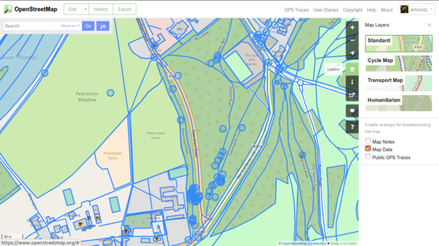

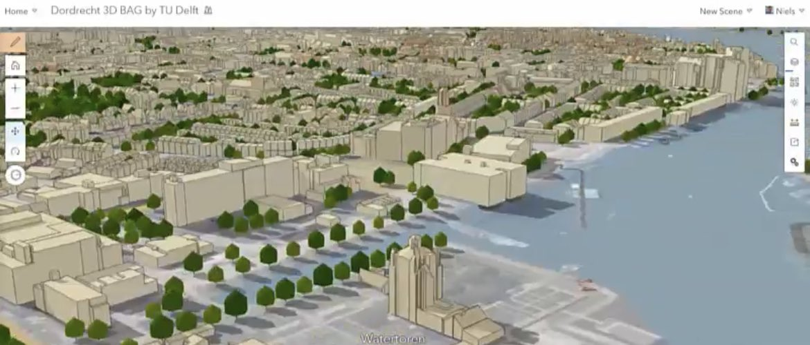

Available Open Data
Notes:
To achieve this objective, I first explored which data sources where available.
For Dutch built environment data I relied on two open datasets: openstreetmap and BAG from the kadaster.
BAG provides very detailed building information, allowing me to distinguish multiple functinos within one building and includes gross floor area which OSM does not provide.
However BAG lacks the functions catering and public transport stops which are available in OSM, so I will use both.

Slide 7

Available Open Data
OPID | TripNr | OPC | DPC | Purpose | Main Mode | Departure H | Leg | Leg Mode
100000 | 1 | 1191 | 1105 | Work | Walking | 8 | 1 | Walking
100000 | 2 | 1105 | 1191 | Home | Walking | 17 | 1 | Walking
100001 | 1 | 1115 | 1081 | Work | Bike | 8 | 1 | Bike
100001 | 2 | 1081 | 1115 | Leisure | Train | 12 | 1 | Bike
100001 | 2 | 1081 | 1115 | Leisure | Train | 12 | 2 | Train
Notes:
I also had access to ODiN which is the national travel survey conducted annually by CBS. It is widely used in Dutch mobility research and contains information on people’s daily travel behaviour, including information on travel purpose, mode and departure hour.

Slide 8
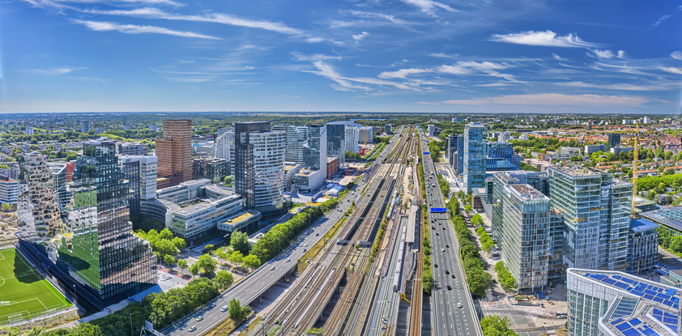
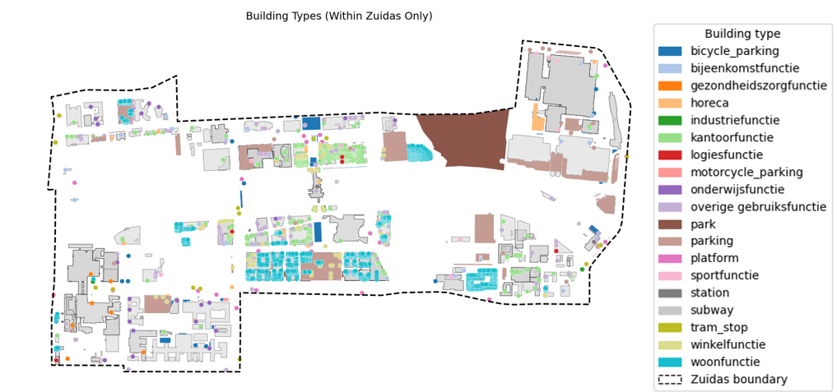
Dutch Urban Context
Notes:
Next part of the objective is to make the model for the Dutch Urban context. So we use dutch data
but also apply the model to a dutch case study for set up and face validation.
For this project the neighbourhood, Zuidas in Amsterdam was selected since it is a mixed use area, including high rice offices, major institutions and residential buildings, and is easily accessible with public transport and has a dense walking network.

Slide 9



Fine Spatial and Temporal Resolution
Household Survey Regression Models:
Fine temporal detail, detailed behaviour & need for detailed surveys
Network Regression Models:
Fine spatial detail, built environment & need for
copious street counts
Building Level UNA Framework of Sevtsuk et al. 2024:
Fine spatial detail with limited data and Models trips between buildings & transit access
Notes:
The last part of the objective is to achieve a fine spatial and temporal resolution.
To see how this can be achieved with the available data, I reviewed the existing literature.
They can be broadly divided into two groups.
The first uses detailed household survey data to capture behaviour well, but require extensive surveys and often lack spatial detail.
The second group consists of network regression which provides fine spatial detail but require extensive pedestrian count data to calibrate flows and therefore aren’t practical.
One model that stood out as though was the UNA model.
It uniquely treated all building types as trip origins, which makes it well suited to mixed-use urban areas. Providing fine spatial detail while relying on relatively limited datasets compared with other approaches.
The main drawback is that it does not include temporal variation, but this can be extended using survey-based methods.
For these reasons, UNA provides the most suitable starting point for developing a pedestrian trip generation model for the Dutch urban context.

Slide 10
UNA Base
Trip Generation
Import Pedestrian Network
Insert Buildings as Nodes
Calculate Reach
Adjust Weights by Reach
Calculate gravity index
Adjust Weights by gravity index
Trip Distribution
Trip Assignment
Model Calibration
Apply Trip Rates to Nodes
Building Data Collection
Assign Weights to Buildings
Assign Weights to Buildings
Determine Trip Rates
Notes:
But how does the UNA model work?
The UNA model starts by giving each building a weight reflecting it’s activity—such as the number of residents, students, or bus lines.
These initial weights are then adjusted based on accessibility.
These serve as the initial estimation of the generated number of pedestrian trips which will be calibrated against observed pedestrian street counts for the morning, midday, and evening peaks after the trip distribution and trip assignment.
CLICK
However in this project I only focus on the trip generation part, which I adapted in three major ways to fit the objective.
CLICK
The first major adaptation of the UNA framework concerns the assignment of building weights using dutch data and to more closely reflect actual activity levels to achieve a finer temporal resolution.
CLICK
The second adaptation is the adjustment of the weights based on accessibility, where I use the reach index instead of the gravity index due to lack of data and use dutch parameters to calculate this reach index.
CLICK
And lastly I integrate hourly trip rates from the ODiN survey.

Slide 11

Assign Weights to Buildings
Study Area Specific Data
Dutch Building Standards
Proxy
Public Transport
Notes:
Let’s take a closer look at the first adaptation: how building weights are assigned to represent the number of unique people using the building in a day.
Building weights are assigned based on the available data.
For residences, education and train station, study area specific data such as number of residents, students or check outs are used.
For building types with know gross floor area, like offices or sport halls, Dutch building standards convert floor space into expected uses, using required floor area per person.
Catering venues lack floor-area data, so they are weighted using local employment as a proxy.
Public transport stops are weighted by the number of lines, frequency and vehicle capacity.

Slide 12
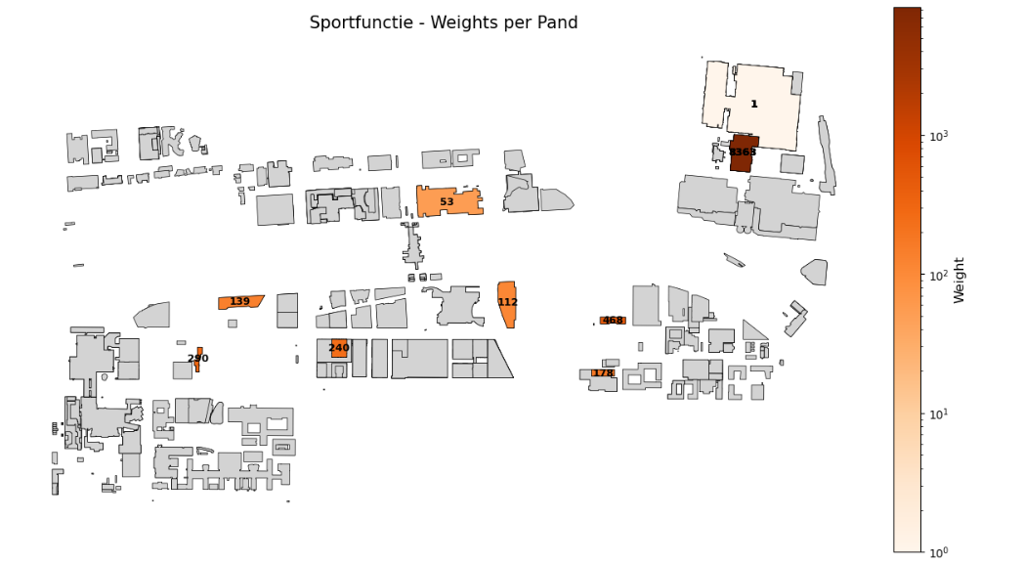
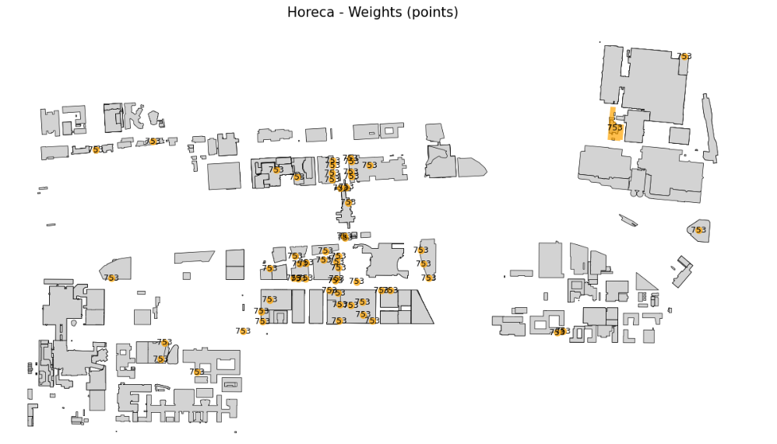
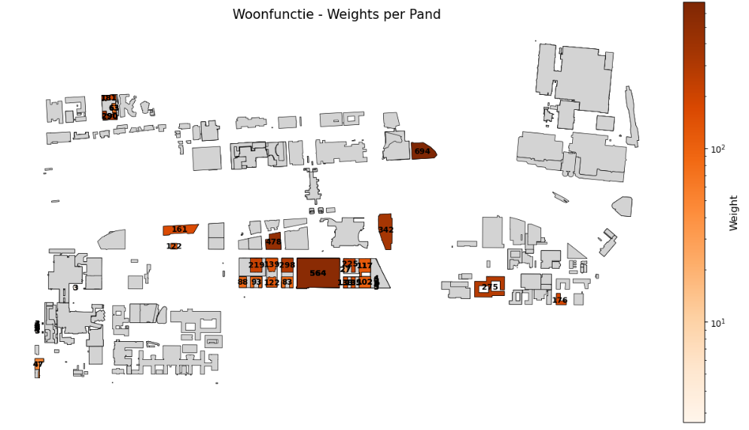
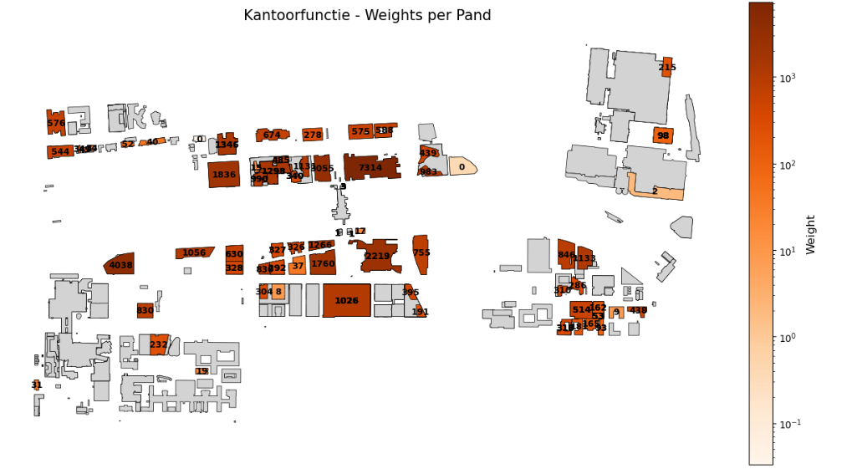
Assign Weights to Buildings
Study Area Specific Data
Dutch Building Standards
Proxy
Public Transport
Notes:
When looking at the results of the weighting methods, the building types using study area specific data as well as .
Buildings weighted using Dutch standards generally produce realistic results, with larger floor areas reflecting higher activity.
However, sports and assembly buildings show some unrealisticly high weights, highlighting that uniform floor-area standards don’t capture the very different usage levels of facilities like small gyms versus large sports fields.
Catering venues present the biggest limitation, showing no difference between a big restaurant or a small café.
When we look at its impact on the final results, trip generation scales directly with the assigned weights, so choosing appropriate weighting methods is critical. In this model, the weights remain within reasonable ranges producing results in the right order of magnitude but we must keep in mind that the different weighting methods do introduce uncertainties and biases.

Slide 13
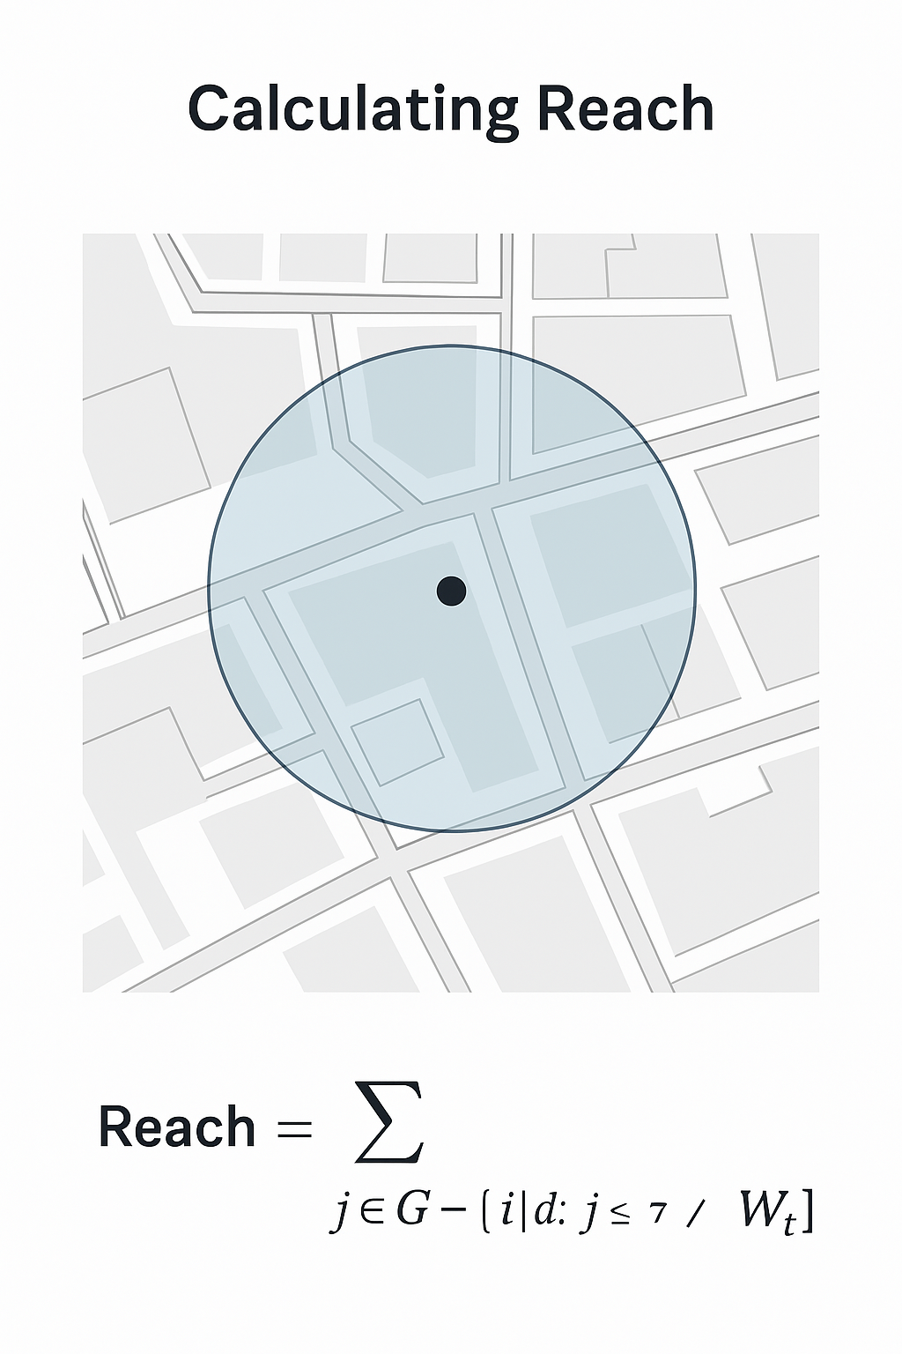
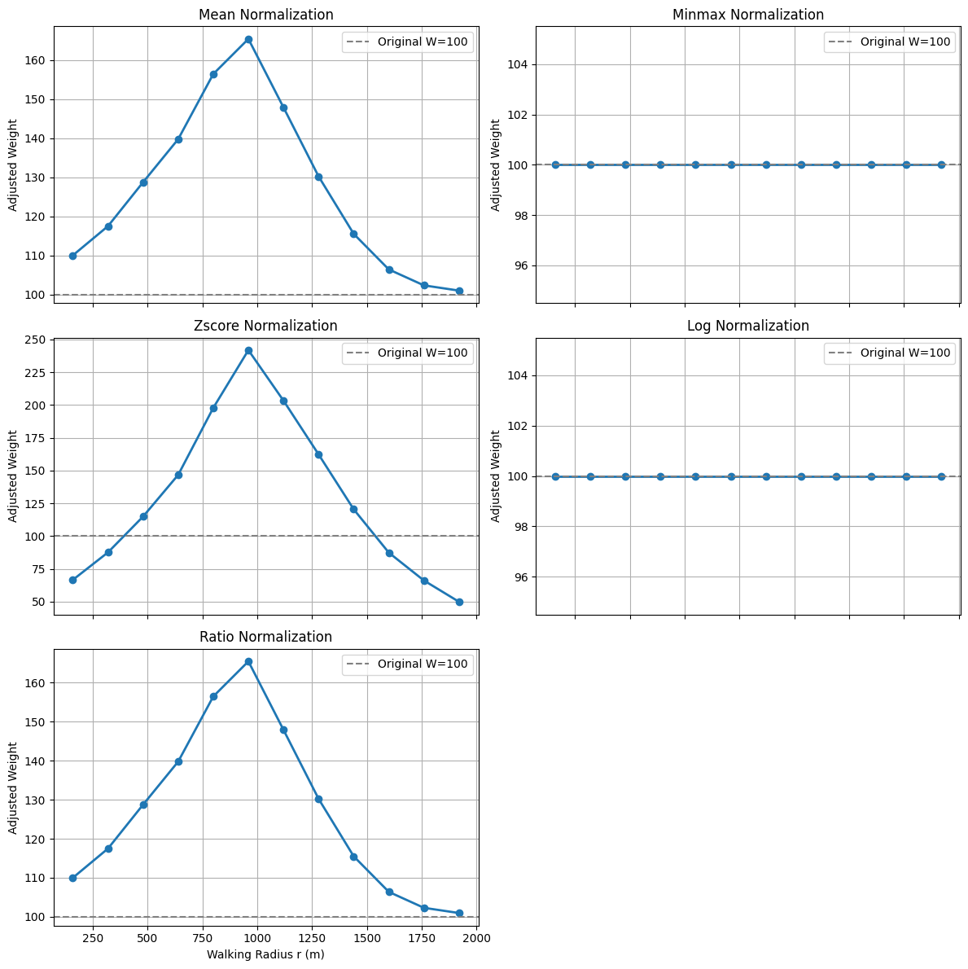
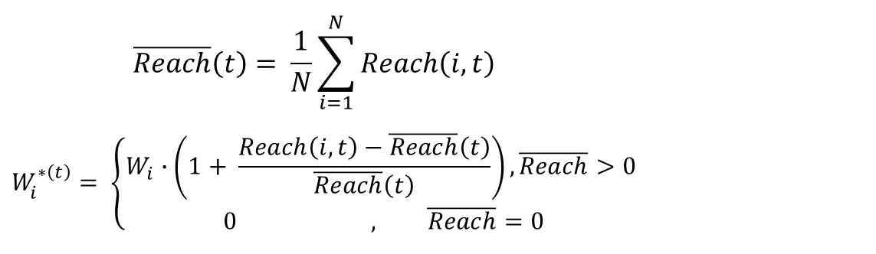
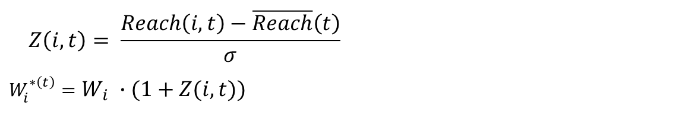
Calculate Reach
$$\overline{Reach}\left(t\right)= \frac{1}{N}\sum_{i=1}^{N}{Reach\left(i, t\right) }$$
$$W_{i}^{∗\left(t\right)}= \left\{\begin{aligned}W_{i}∙\left(1+ \frac{Reach\left(i, t\right)−\overline{Reach}\left(t\right)}{\overline{Reach}\left(t\right)}\right), \overline{Reach}>0 \\ 0 , \overline{Reach}=0\end{aligned} \right.$$
W2
W3
W4
$$Z\left(i,t\right)= \frac{Reach\left(i, t\right)−\overline{Reach}\left(t\right)}{σ}$$
$$W_{i}^{∗\left(t\right)}=W_{i} ∙(1+Z(i,t))$$
W5
W1
Reach = W1 + W2 + W3 + W4 + W5
$${Reach}_{t} {\left[i\right]}^{r}=\sum_{jεG−\left\{i\right\},d\left[i , j\right]≤r}{W_{t}\left[ j\right]}$$
Notes:
The second component of the methodology is adjusting the weights based on their accessibility by calculating their Reach Index.
This is to reflect the assumption that locations with better access to destinations generate more walking trips.
The Reach Index sums the weights of all destinations of a given type within walking distance of a building.
The initial weight then adjusted using a normalization method.
Several methods were tested on a synthetic grid where all buildings were given a weight of 100 to illustrate their impact.
The mean based method centres values around the average, increasing weights for buildings with an above average accessibility and reducing them for those below average.
The Z-score method does something similar but includes the standard deviation so it will exaggerate the diffferences
For both methods we see that as walking radius increases, accessibility first grows and then levels off once most buildings get the same level of accesibility. However, for the Z-score it exaggerates small differences and therefore might introduce unrealistic results, therefore the mean based method was selected, using the average waking distance in the Netherlands as the radius.

Slide 14
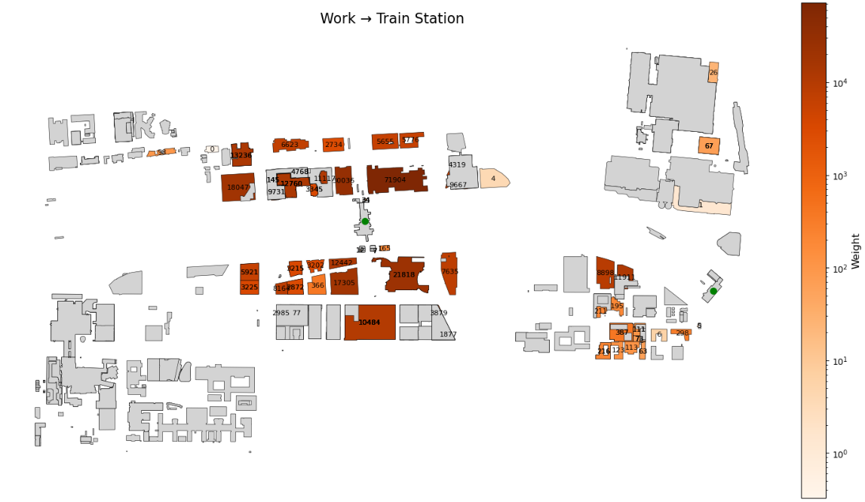
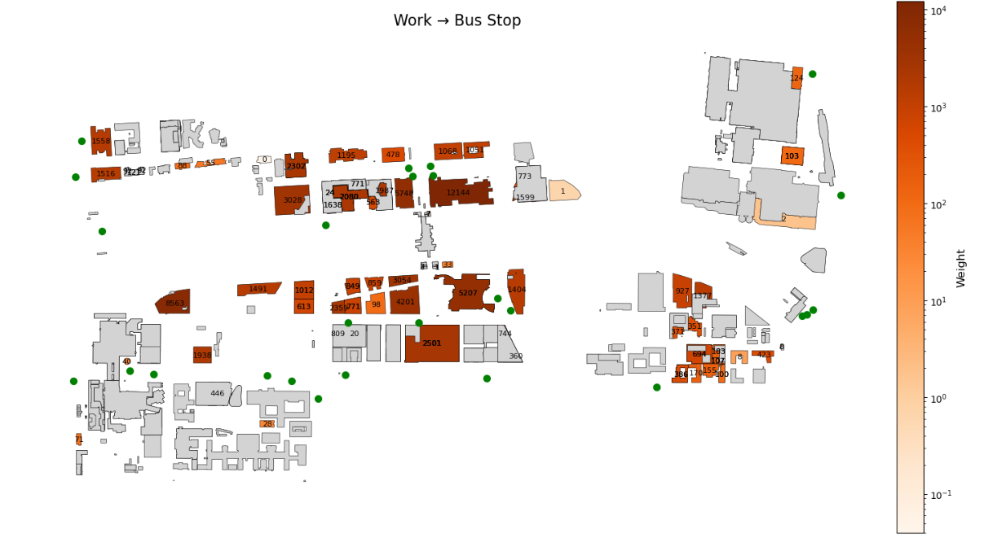
Calculate Reach
Notes:
Applying reach shows how accessibility changes building weights. Offices within walking distance of a train station can see weights increase up to tenfold, while those outside get zero. For bus stops, the effect is smaller, more realistic, more nearby stops moderately increase or decrease weights.
from these results we see that rare destinations like train stations can produce very large weights, adding uncertainty. Reach scaling is still under-researched, and More data is needed for proper study, but the method captures meaningful accessibility differences and produces plausible results.

Slide 15
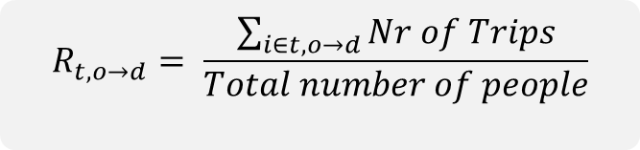
Determining Trip Rates
Trip Purpose | Mapped Building Type
Going home | Home
Work | Work
Business visit | Work
Professional activity | Work
Pick up / drop off a person | Other
Pick up / drop off goods | Other
Education / course | Education
Shopping / groceries | Shopping
Visiting friends or staying overnight | Home
Touring / strolling | Leisure
Sport / Hobby | Sport
Other leisure activities | Leisure
Services / personal care | Healthcare
$$R_{t,o→d}= \frac{\sum_{i∈t, o→d}{Nr of Trips}}{Total number of people}$$
Trip Type | Filter Logic | Origin | Destination
Home -> Purpose | First trip Main mode is walking | Home | Trip Purpose
Home -> Transfer Point | First trip, First leg Main mode is not walking Mode of leg is waking | Home | Main Mode of Trip
Non-Home Walking Trips | Not the first trip Main mode is walking | Purpose of Previous Trip | Trip Purpose
Non-Home -> Transfer | Not first trip, First leg Main mode is not walking Mode of leg is walking | Purpose of Previous Trip | Main Mode of Trip
Transfer Point -> Final Purpose | Last leg Main mode is not walking Mode of leg is waking | Main Mode of Trip | Trip Purpose
Notes:
The final component adds hourly resolution using trip rates, inspired by household survey models.
While ODiN reports trips at the postal code level, this model uses building types as origins.
Thus trip purposes from ODiN are mapped to building types.
According to literature most of the trips go to highly predictable land-use types given their purpose for categories like home or education, but broaders purposes like work or leisure introduce uncertainty as they can correspond to a multiple of land use types.
Furtermore, number of trip purposes are smaller than number of building types meaning building types are aggregated under on trip purpose also introducing uncertainty
However, the mapping this way ensure comparability .
Thus trip rates are calculated by setting the origin by the previous trip or home for the first trip of the day and the destination by the trip purpose of the trip.
Hourly rates were then computed as the number of trips per origin–destination category per hour, divided by total survey respondents.

Slide 16
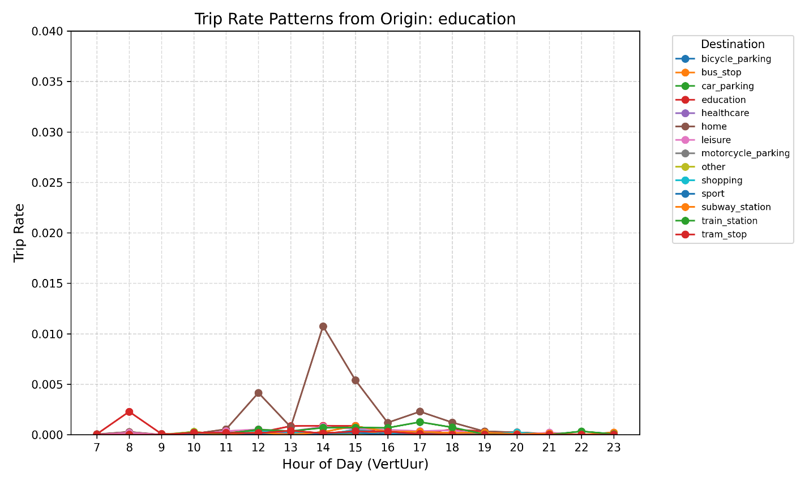
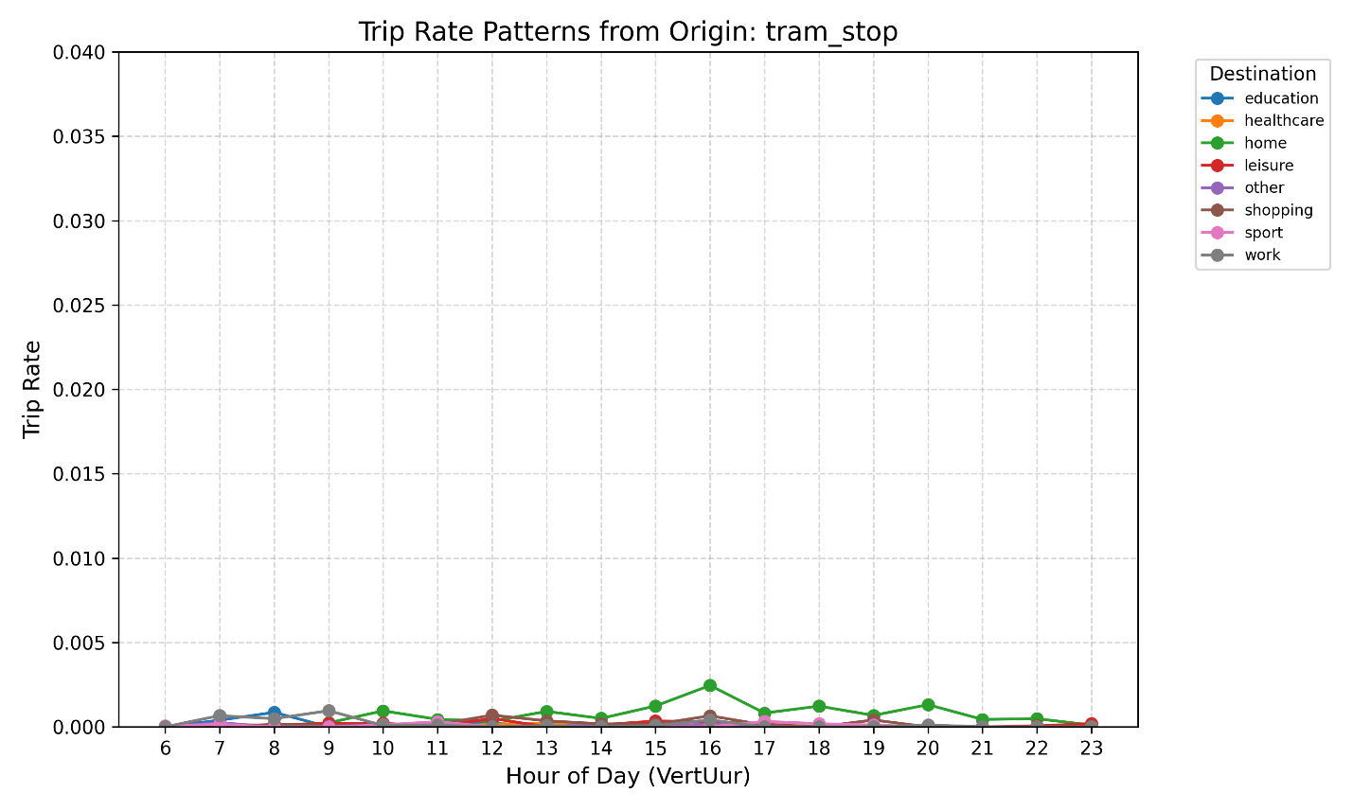
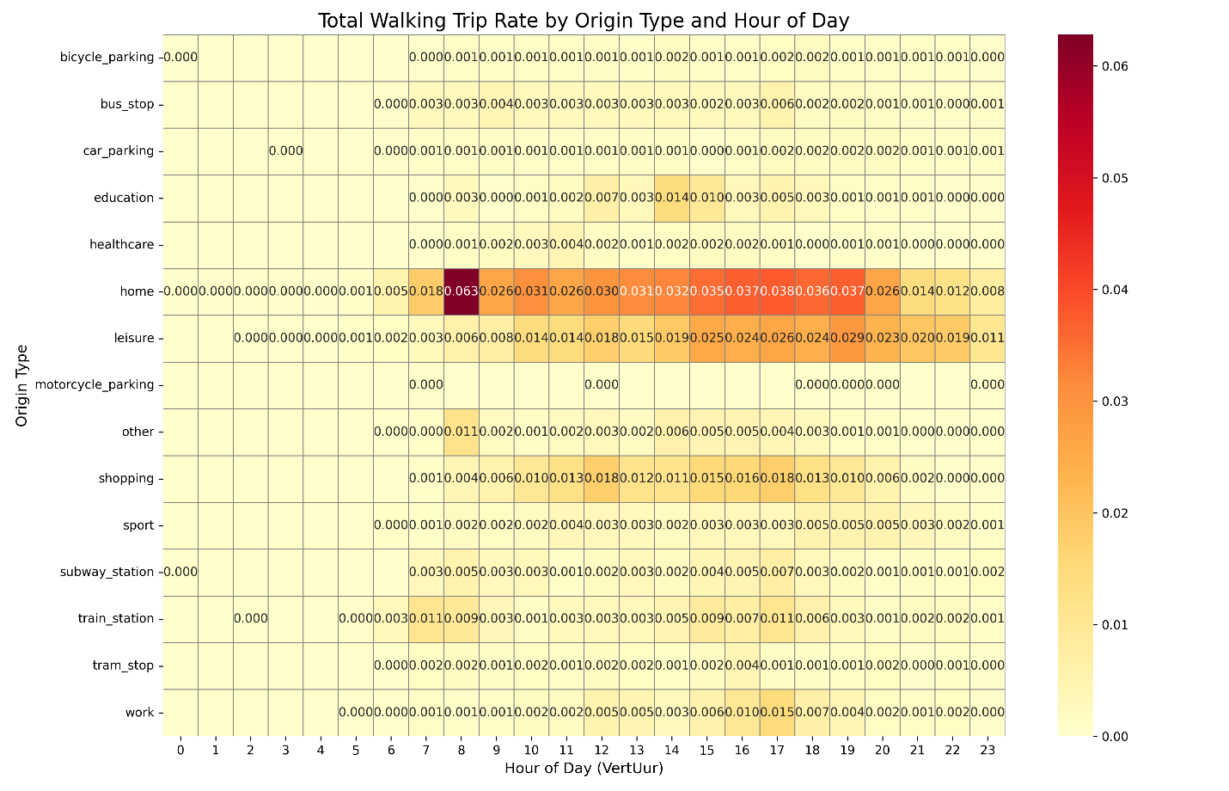
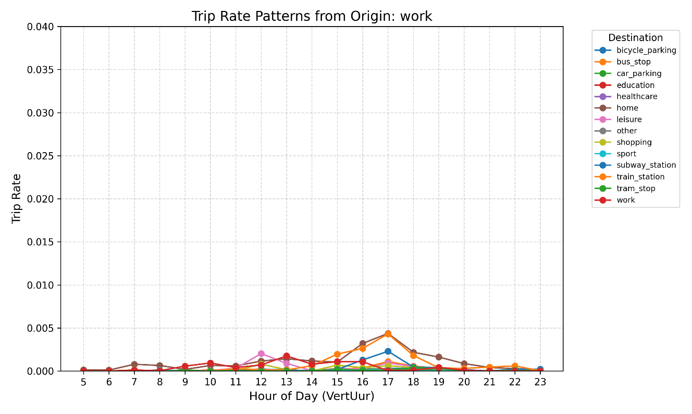
Determining trip rates
Notes:
To illustrate the results, I made a heatmap showing per origin per hour the trip rates.
This shows peaks at the expected times, like morning commuting trips, and afternoon returns.
Trip rates from work, education, and transit stops are lower than expected, suggesting that multimodal trips, return trips, and lunch walks are underreported, a pattern noted in previous research.
Despite this, the dataset captures daily pedestrian fluctuations well enough for baseline trip estimates.

Slide 17

Generating Trips
$$G_{n,t,o→d}=W_{n,d}∙R_{t,o→d}$$
W:
R:
NodeID | Origin | Home | Work | Leisure | … | Train Station
100001 | Home | A1 | B1 | C1 | … | D1
100002 | Home | A2 | B2 | C2 | … | D2
100003 | Work | A3 | B3 | C3 | … | D3
VertUur | Origin | Destination | Trip Rate
8 | Home | Home | X8
8 | Home | Work | Y8
8 | Home | Leisure | Z8
8 | Home | Train Station | W8
12 | Home | Work | Y12
17 | Work | Home | X17
G:
NodeID | VertUur | Home | Work | Leisure | … | Train Station
100001 | 8 | A1 * X8 | B1 * Y8 | C1 * Z8 | … | D1 * W8
100002 | 12 |  | B2 * Y12
100003 | 17 | A3 * X17
Notes:
Now that we have all the components the generated trips can be calculated.
In this step, the previously derived trip rates are applied to the adjusted building-level weights in order to estimate the number of trips generated by each node in the study area. Trip generation is performed per node, per destination type, and per hour, ensuring that the temporal and functional dimensions of pedestrian travel are captured.

Slide 18
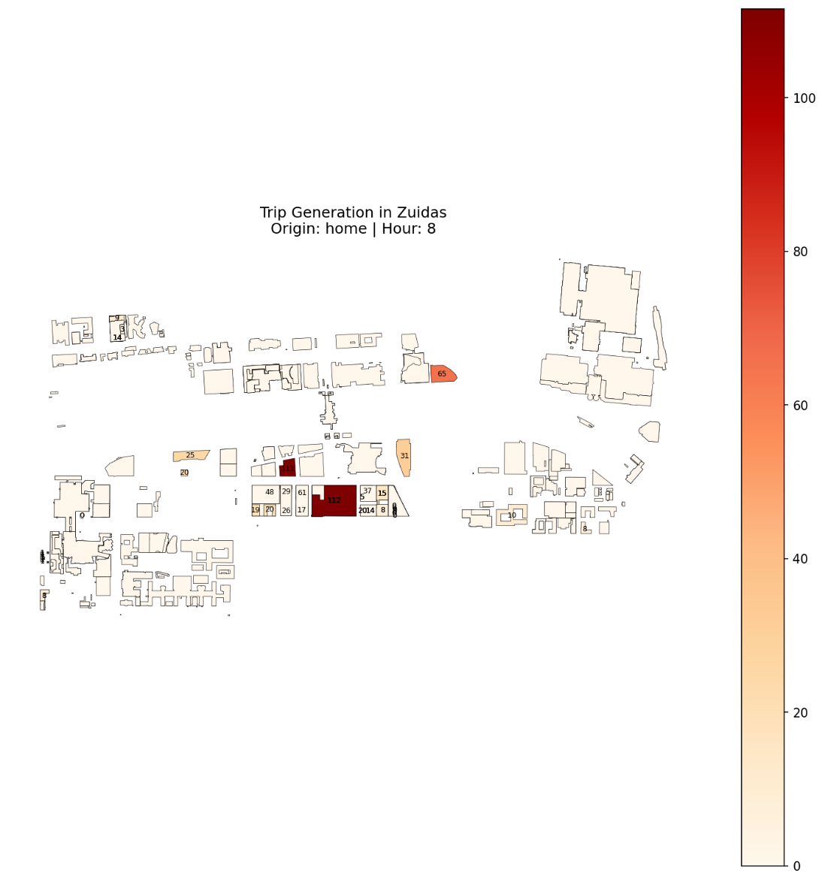
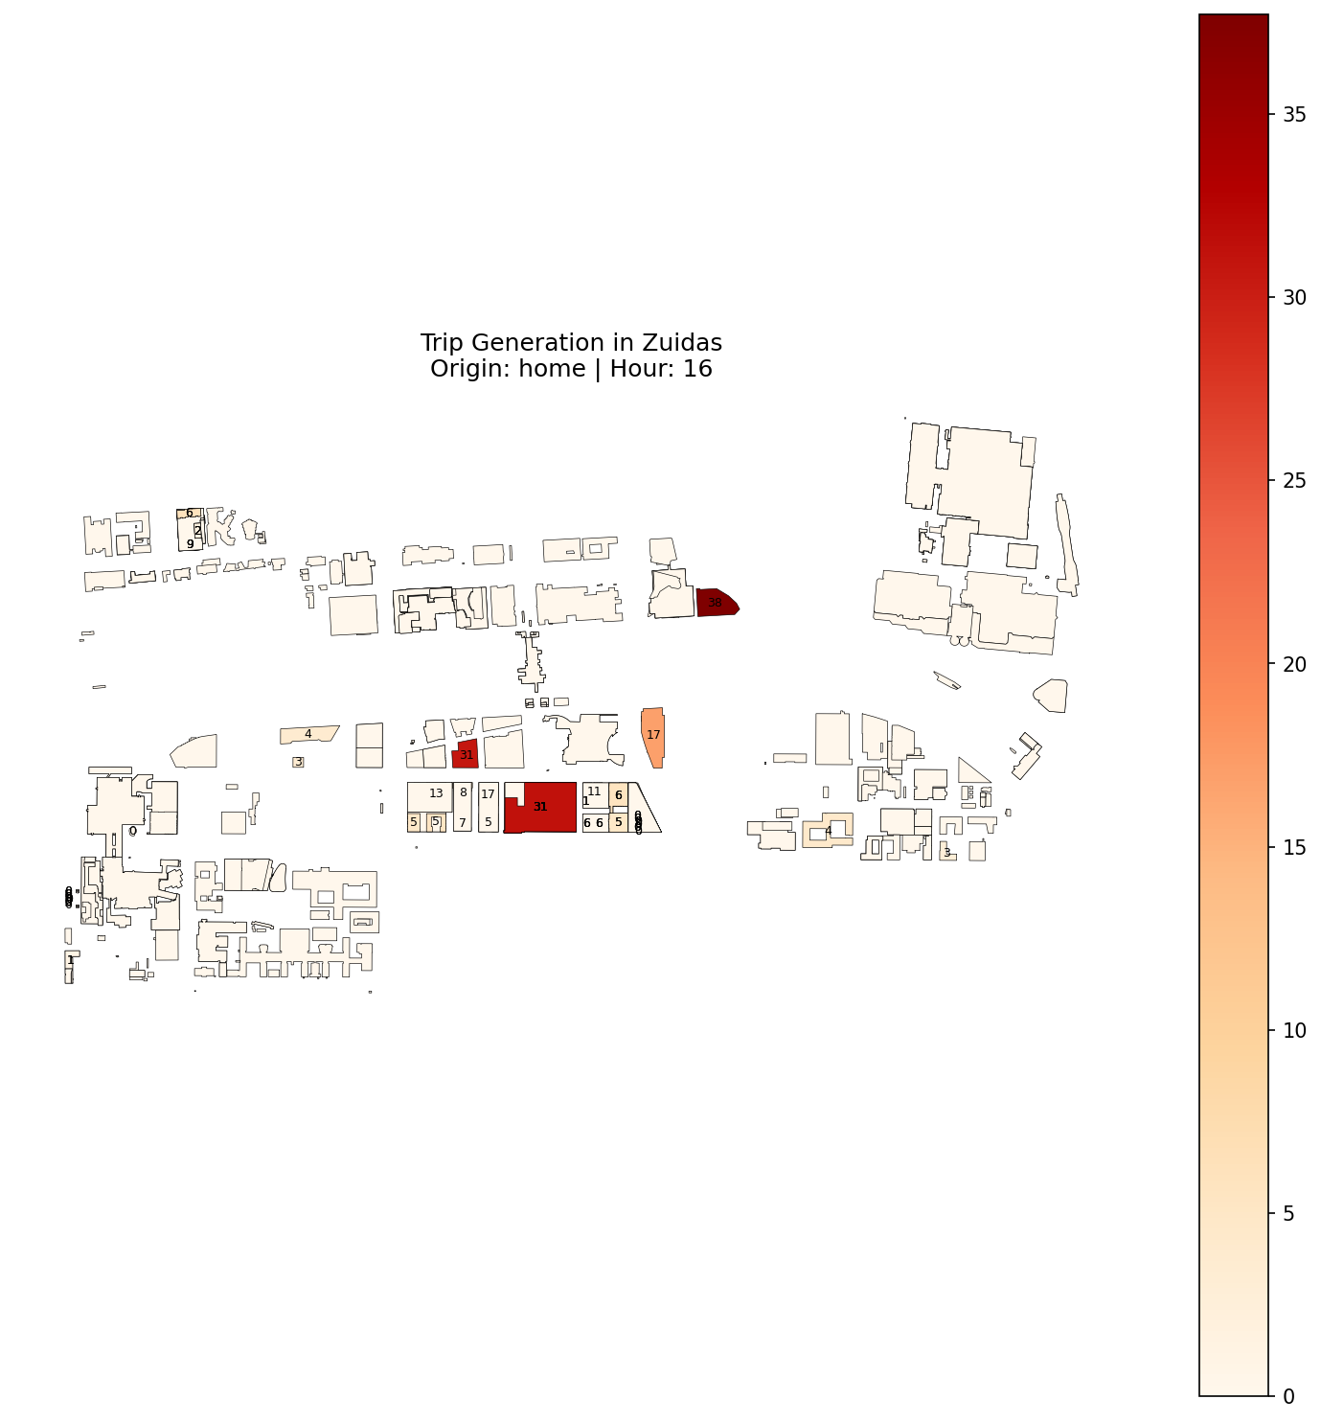
Generating Trips
Notes:
As a final step, the total number of trips generated per node is calculated by summing across all destination types. This provides a straightforward consistency check to validate the plausibility of the generated trips.

Slide 19
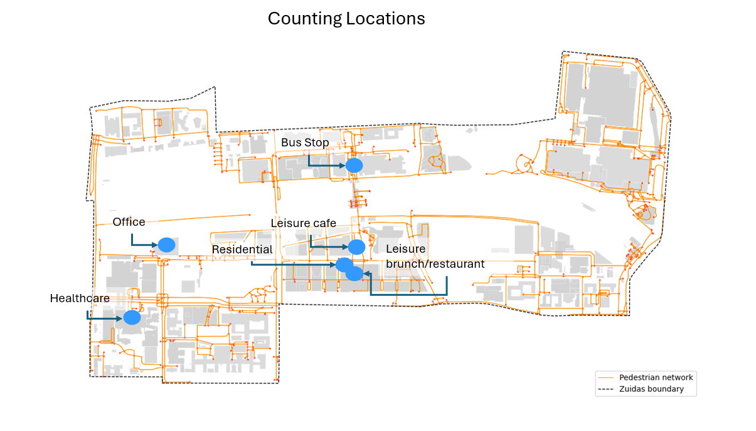
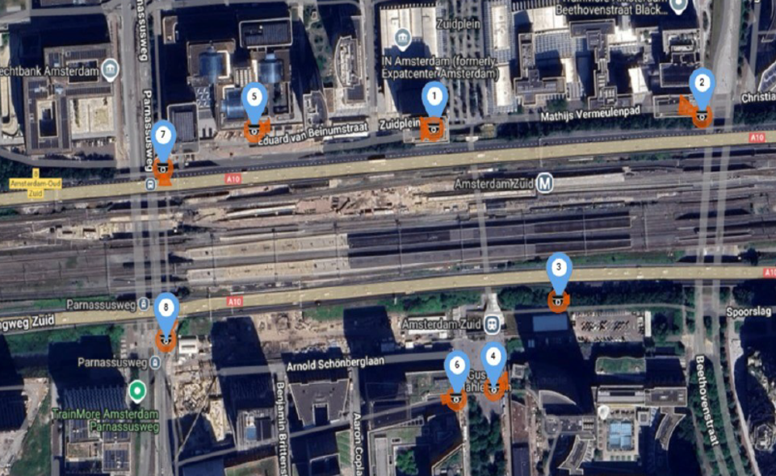
Face Validation
Notes:
To check plausibility, pedestrian departures were counted at several buildings and at Zuid train station for a few summer days. These limited counts provide a rough check of magnitude, hourly patterns, and differences between building types, but are not sufficient for full validation.

Slide 20
Face Validation
Origin type | Departure hour | Counted | Predicted | Factor difference
Train Station | 8 | 1777 | 1144 | 1.55
Train Station | 12 | 645 | 196 | 3.29
Train Station | 17 | 442 | 251 | 1.76
Home | 8 | 24 | 18 | 1.33
Home | 9 | 13 | 6 | 2.17
Office | 12 | 197 | 12 | 16.42
Office | 17 | 334 | 36 | 9.29
Leisure | 8 | 8 | 3 | 2.67
Leisure | 9 | 28 | 5 | 5.6
Leisure | 17 | 9 | 18 | 0.5
Bus Stop | 8 | 167 | 261 | 0.64
Bus Stop | 12 | 154 | 77 | 2
Bus Stop | 17 | 235 | 156 | 1.51
Notes:
Comparing predicted walking trips with observed counts shows that the model produces plausible magnitudes.
Accuracy is the high for building types with study area specific weights like homes and train stations.
While offices and Leisure locations, based on building standards and proxies are underpredicting.
What we can also notice is that morning peaks are captured best, whereas midday and evening trips are often underestimated.
Bus stops, despite a different weighting method, perform reasonably well, but compared to offices and leisure, indicating that the way that acticvity levels where estimated where good, but might still suffer of underrepresentation of short walking legs in ODiN.
These results show that reliable, area-specific weighting data improves the consistency and accuracy of the model, but getting the order of magnitude right is most important. Factor differences are largest for trips that ODiN is known to underreport, such as lunchtime or return trips, so the model is most reliable for morning peaks.
Overall, the model produces plausible results, maintains the correct order of magnitude, and captures spatial and temporal variations in walking demand.

Slide 21
Discussion & Conclusion
Furture Research
Calibrate using street counts or Incorporating mode choice
Improve land-use-specific survey data.
Improve accessibility index
Notes:
This model successfully adapts the UNA framework to the Dutch context, bridging household-survey and network-regression approaches while using less data-intensive methods.
However, several limitations should be noted. The model relies heavily on initial weighting, and many building weights are based on proxies—when these proxies are inaccurate, performance declines. The accessibility component also introduces uncertainty, as walking radius and Reach normalization is still under researched.
Trip purposes in ODiN do not always match building functions—broad categories like “leisure” addd uncertainty when assigning trips.
Validation data were limited to a few buildings and periods, serving mainly as a plausibility check rather than full statistical validation.
These limitations highlight areas for future research:
Is to add trip distribution and trip assignment, to calibrate the model using street counts.
Alternative modeling structures, such as estimating trips first and applying mode choice later.
Improved survey data better linking trip purposes to building types and capturing short or underreported walking trips.

Slide 22
Discussion & Conclusion
Key Strengths & Usage
It improved spatial and temporal resolution
Useful for identifying key pedestrian generators
Solid base for trip distribution and trip assignment
Notes:
Despite the uncertainties, the model has several important strengths.
It is:
transparent and reproducible
applicable to mixed-use urban environments
and able to capture daily variation in walking demand
In practice, the model can already be used to:
identify key pedestrian generators
and test planning scenarios — for example, adding new buildings or amenities
It is particularly useful in situations where relative patterns and changes are more important than exact totals, such as early-stage planning and policy evaluation.
So overall, this thesis demonstrates that an open-data, building-level, hourly pedestrian trip-generation model for Dutch cities is both feasible and valuable — and it lays the groundwork for future development toward fully calibrated pedestrian flow modelling.

Slide 23
Title slide + symbol #1
Thank you for your Attention!
Supervisors: Dr. M. Snelder, Dr.ir. D.C. Duives,
Dr.ir. W. Daamen, Dr.ir. A. Nadi Najafabadi
Department: MSc Civil Engineering, TTE
Date: 07-01-2026

